Slide 1
Visualisation of Los Angeles Crime Data using Tableau
Team Members:
Mowzli Sre Mohan Dass
Praneeth Sarva
Saikrishna Paila

Slide 2

About the Dataset
Los Angeles City Crime Data - 2020 to 2023
Source: https://catalog.data.gov/dataset/crime-data-from-2020-to-present
900k Rows with 29 Columns
Important columns: Reported Datetime, Crime type, Age, Gender, Crime Codes, Coordinates, Area Names and Premises of Crime

Slide 3
Data Preprocessing
Null values were removed using python
Date and time format has been changed for Tableau’s format
Lat and Lon Coordinates were trimmed within the boundaries of Los Angeles City
Dataset is finally cleaned and imported in Tableau for visualisation

Slide 4
Business Questions Areas
Crime Rate Dynamics
Crime Categorization and Investigation Status
Geographical and Demographic Factors
Victimology
Impact Analysis

Slide 5

Crime Rate Dynamics
What are the areas in Los Angeles with the highest crime rates and how have these rates changed over the years 2020 to 2023?
A side-by-side bar chart is created over the time with number of cases
Grouped in hierarchy of month, quarters and year
Minimum of 15k crimes and maximum of 21k were reported during the period of 2020 - 2023

Slide 6
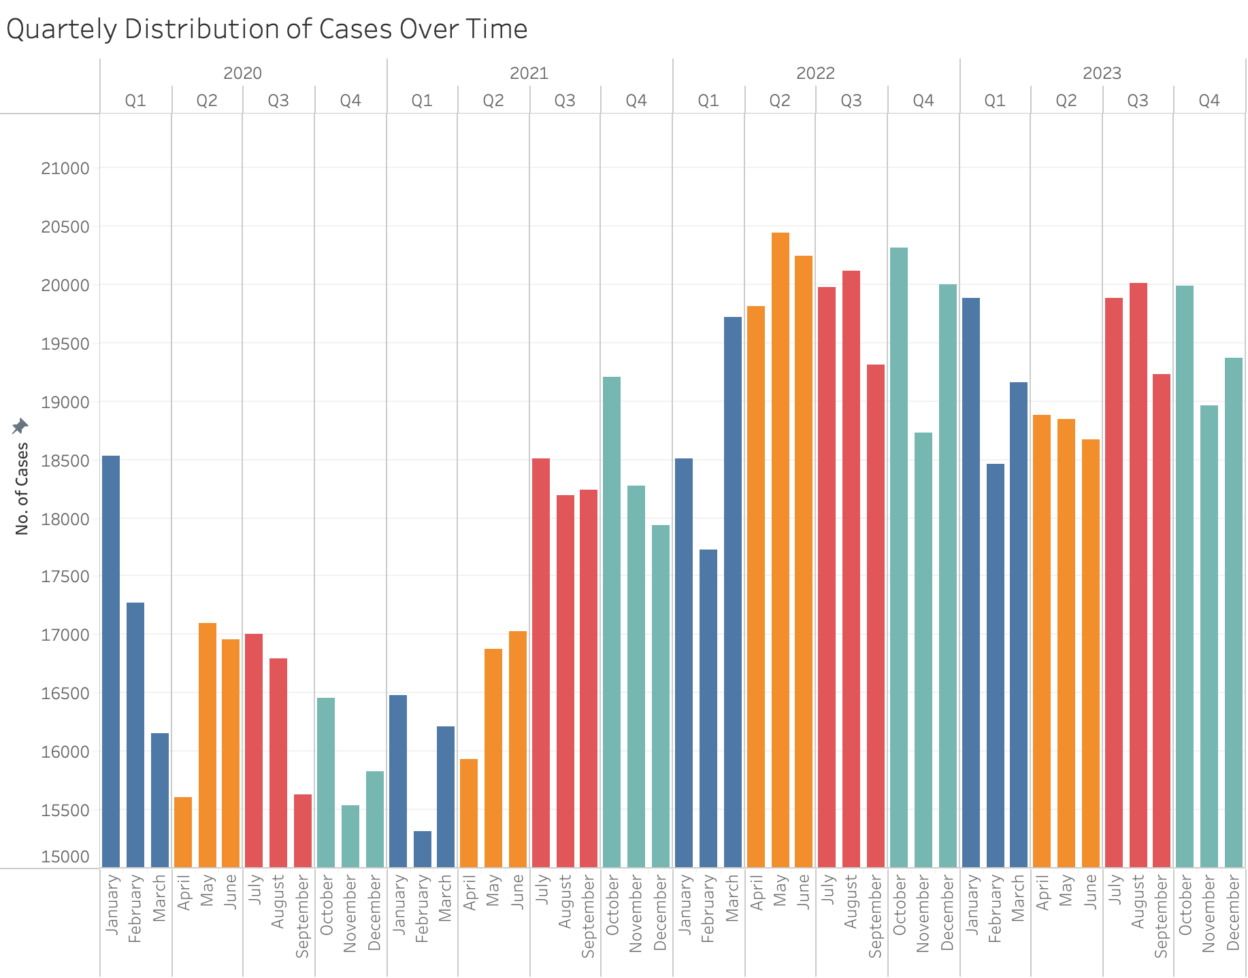
Crime Rate Dynamics

Slide 7
Crime Rate Dynamics
Which times of day and days of the week exhibit the highest crime occurrences, and how does this vary by gender?
An aesthetic line is chosen for representation
Two lines distinguishing Male and Female were plotted against the hourly course
Observed that afternoons are most vulnerable time for crimes to happen

Slide 8
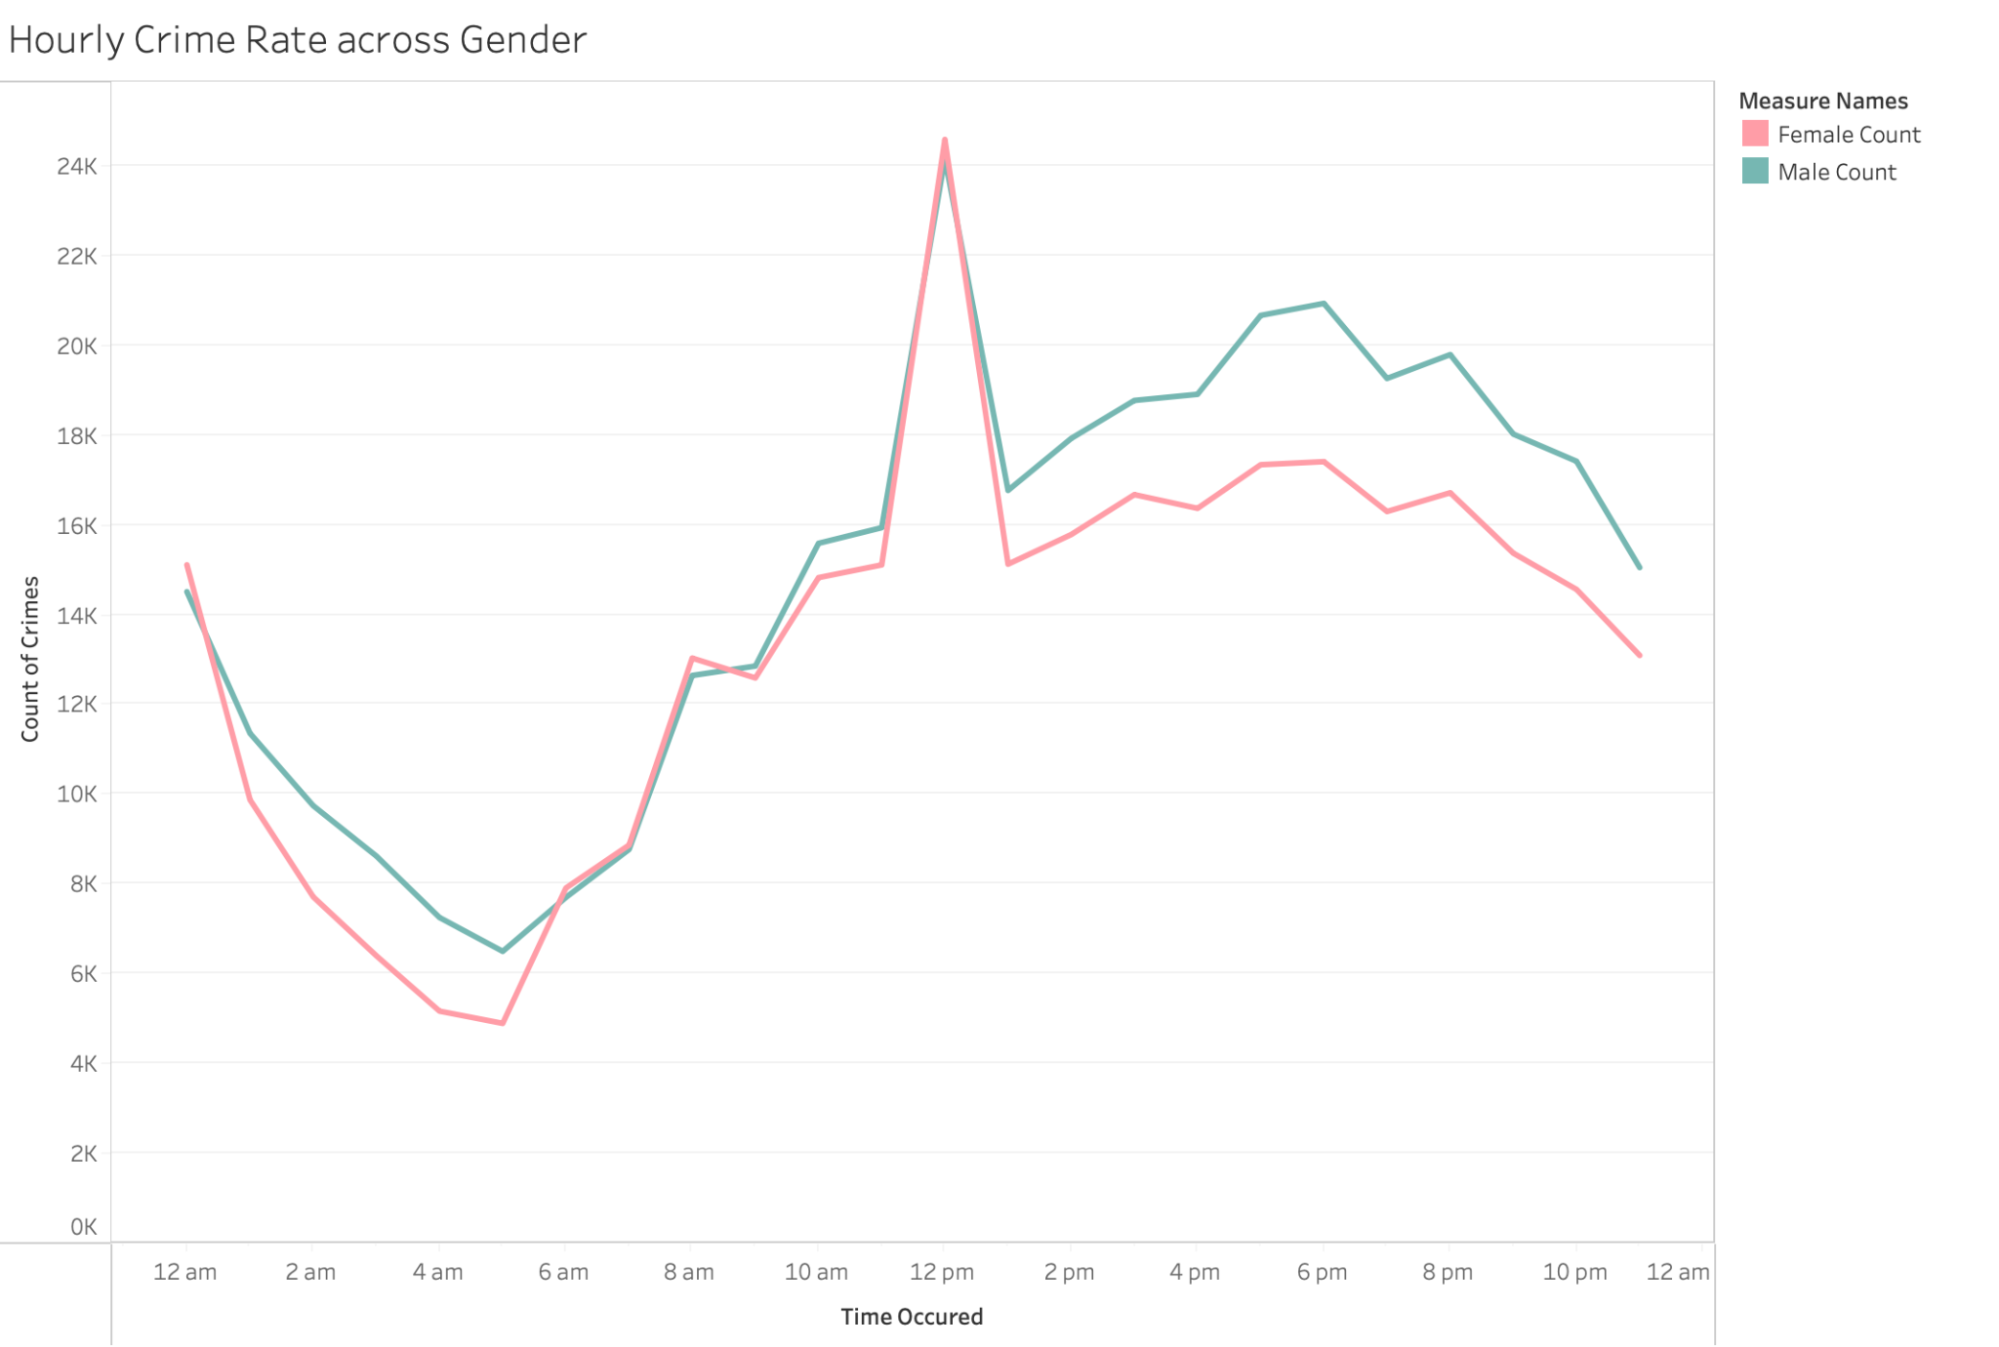
Crime Rate Dynamics

Slide 9

Crime Categorization and Investigation Status
What are the most common crime categories in Los Angeles, and how does the status of investigations vary across these categories?
A dynamic Tree map is used to identify the proportion of crime rate
A Calculated field “Percentage of Crime” is created
COUNT(IF [Crime Description] = ([Crime Description]) THEN 1 END) / TOTAL(COUNT([Crime Description]))

Slide 10
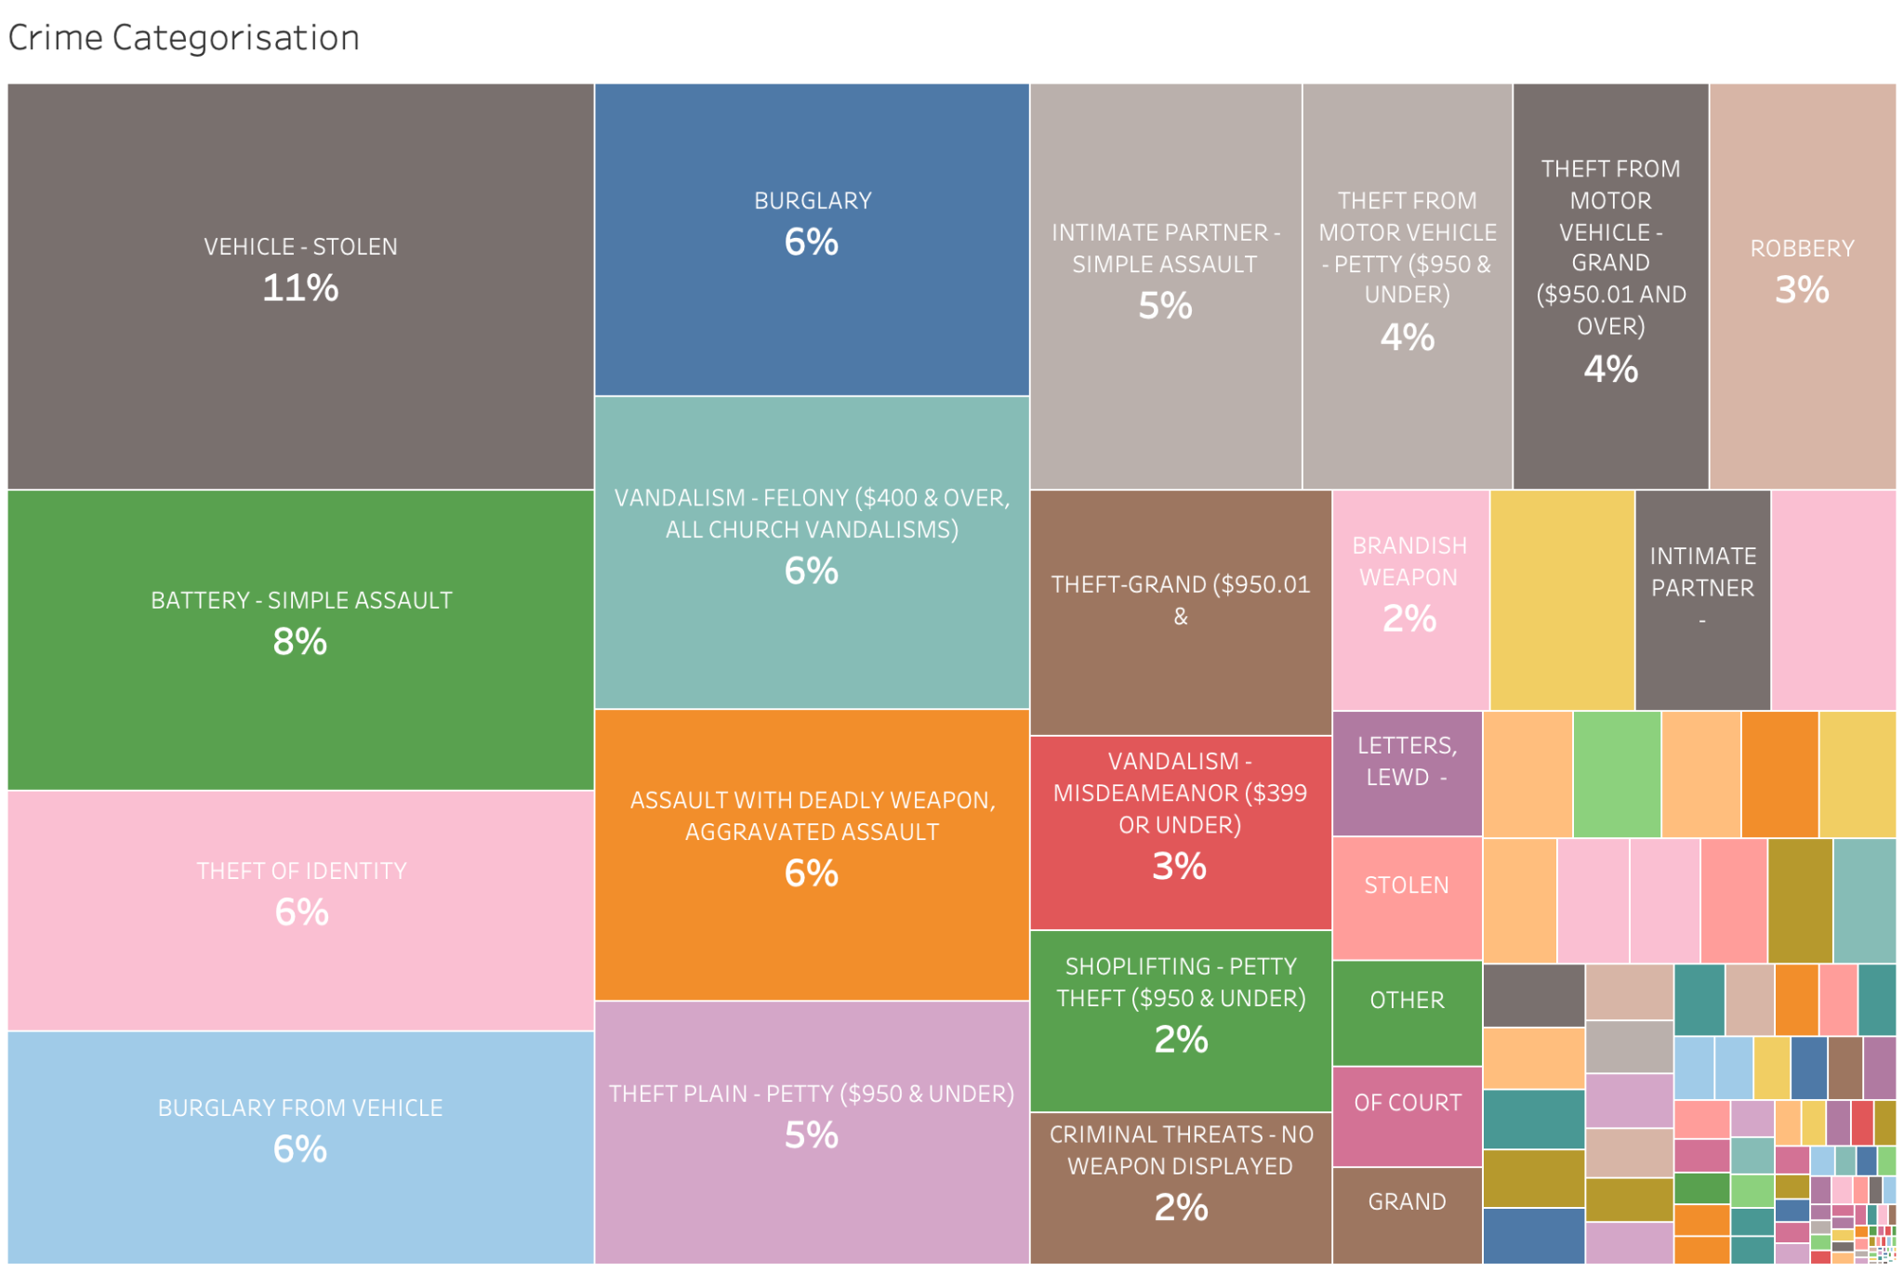
Crime Categorization and Investigation Status

Slide 11
Crime Categorization and Investigation Status
Are certain types of crimes more likely to be unresolved or shelved compared to others?
The status of the crime is plotted against the percentage of cases happened based on crime category
This gives a stacked bar chart of the status of each crime
It is evident that most of the cases are shelved, with more significant number of pending cases among all the crimes

Slide 12
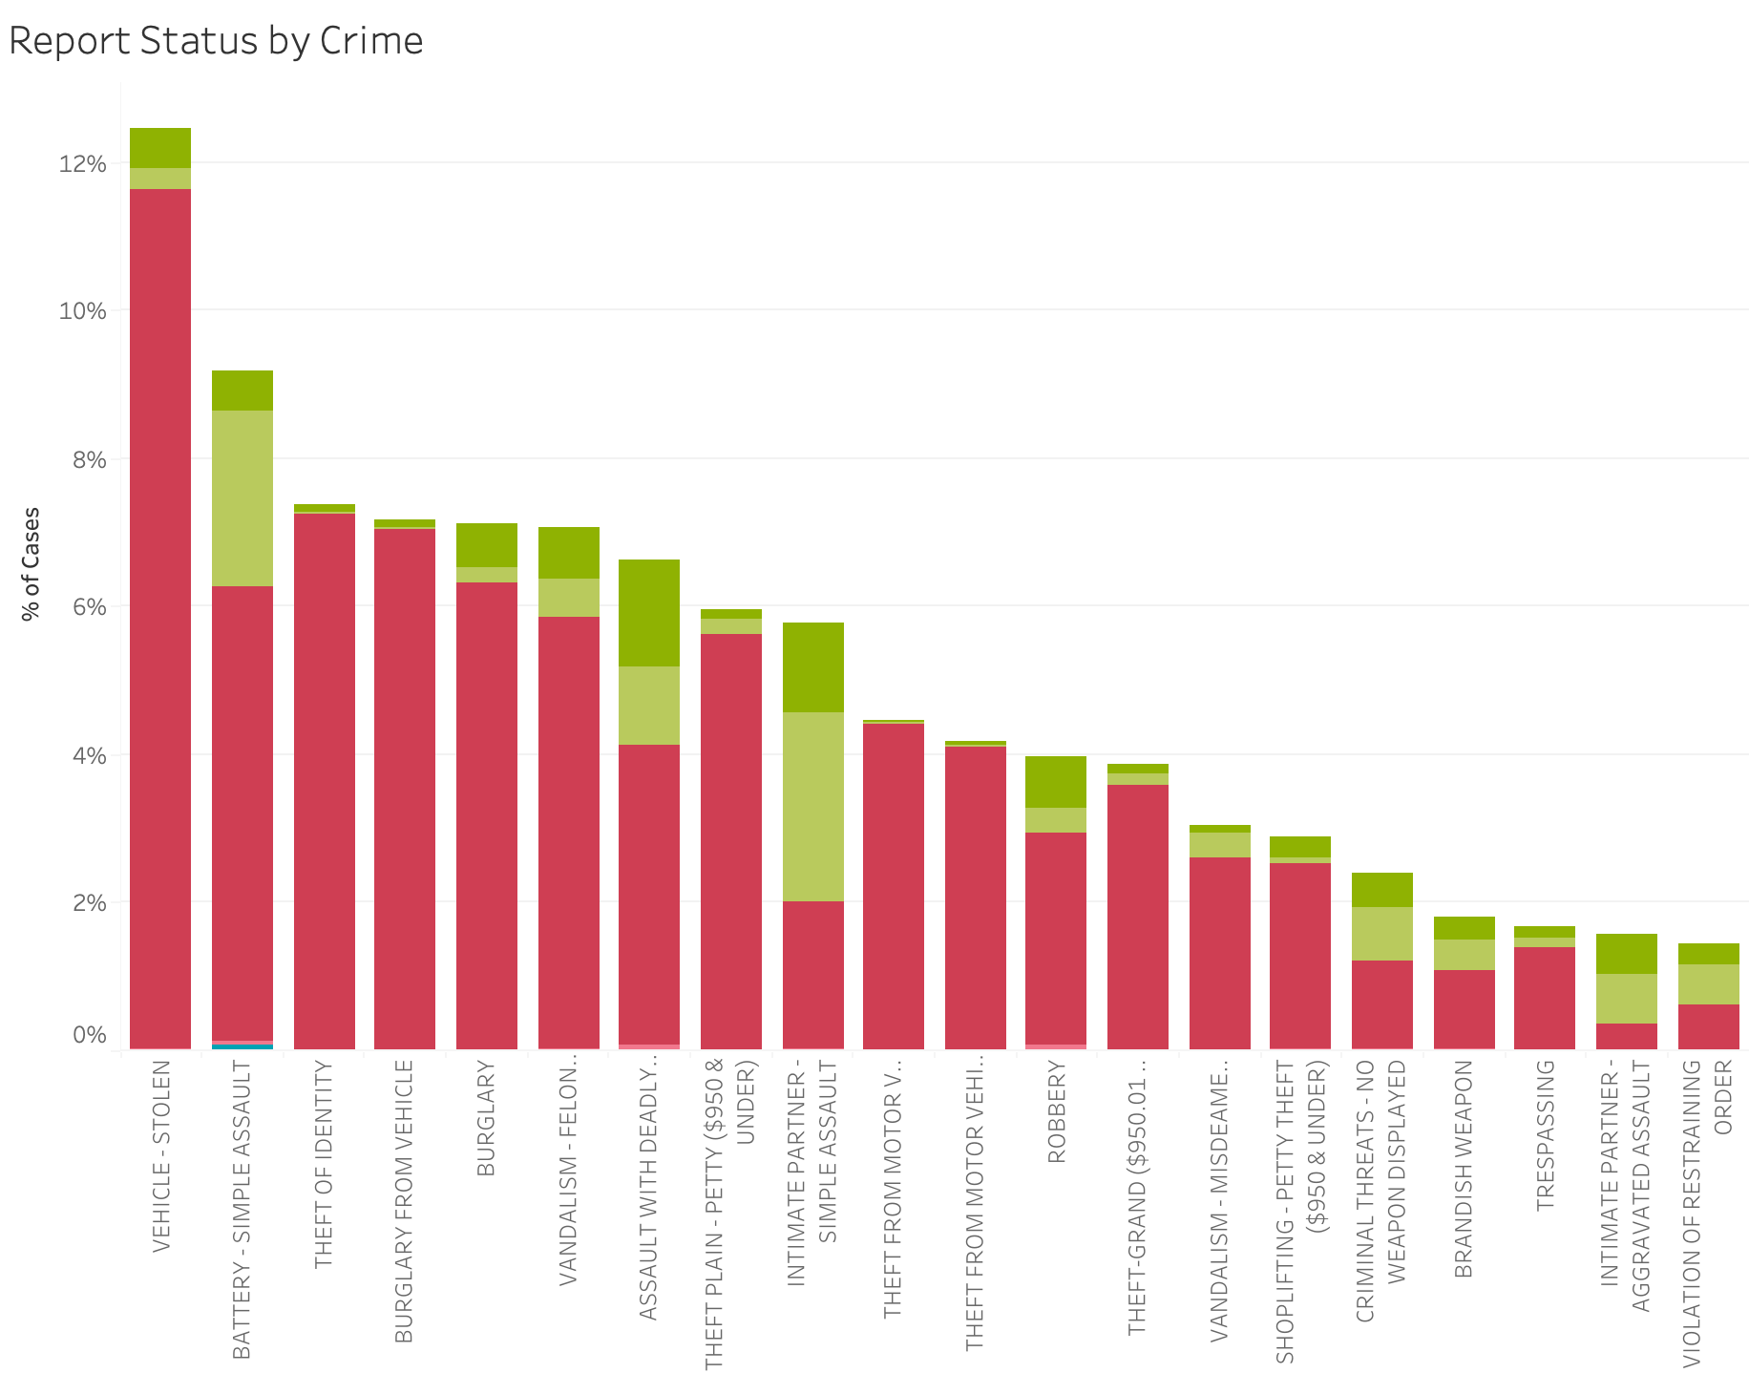
Crime Categorization and Investigation Status

Slide 13
Crime Categorization and Investigation Status
Which area in the city is more likely to be have unresolved cases?
The status of the crime is plotted against the percentage of cases happened based on the area name
A stacked bar chart of the status of each location is created
Most of the cases are unresolved, but the jurisdiction shows equal importance to all the location

Slide 14
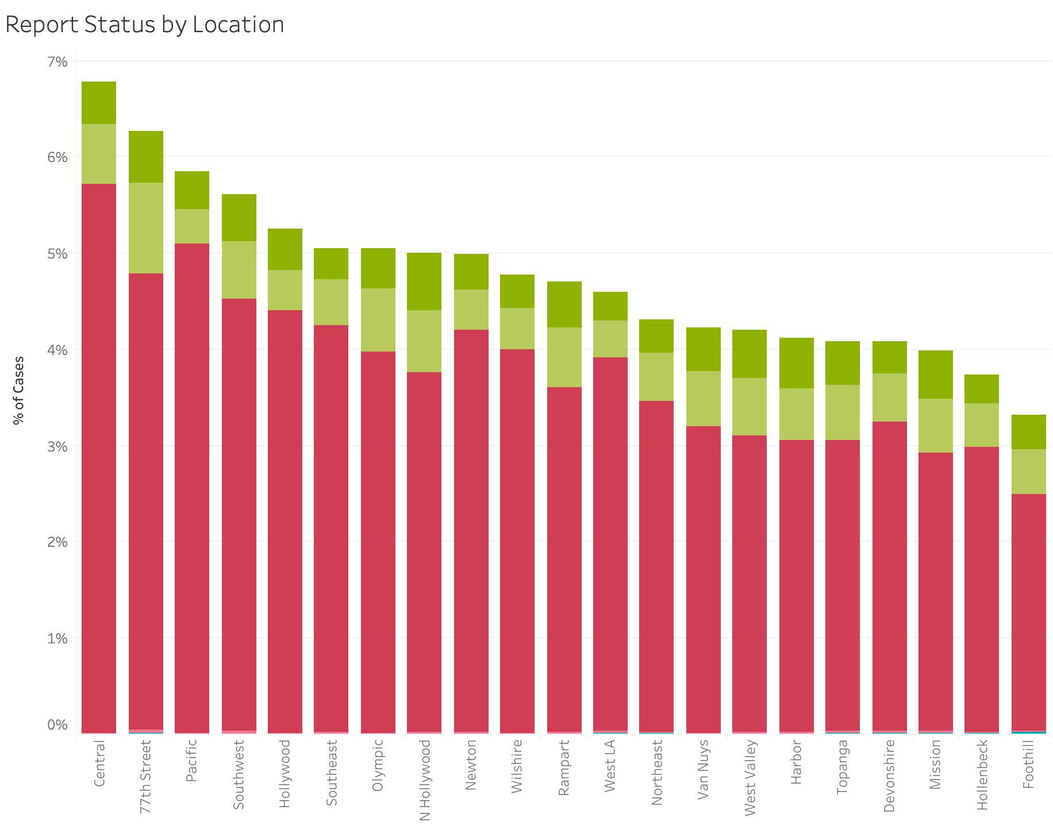
Crime Categorization and Investigation Status

Slide 15
Geographical and Demographic Factors
How does crime distribution vary across different locations in Los Angeles?
Number of crimes have been visualised on top of LA map describing the number of cases occurred
A total of 21 Locations with number of cases have been visualised on the LA map
We found out the minimum number of cases have occurred in Foothil with 29k cases and The maximum cases have occurred in central with 59k occurrences.

Slide 16
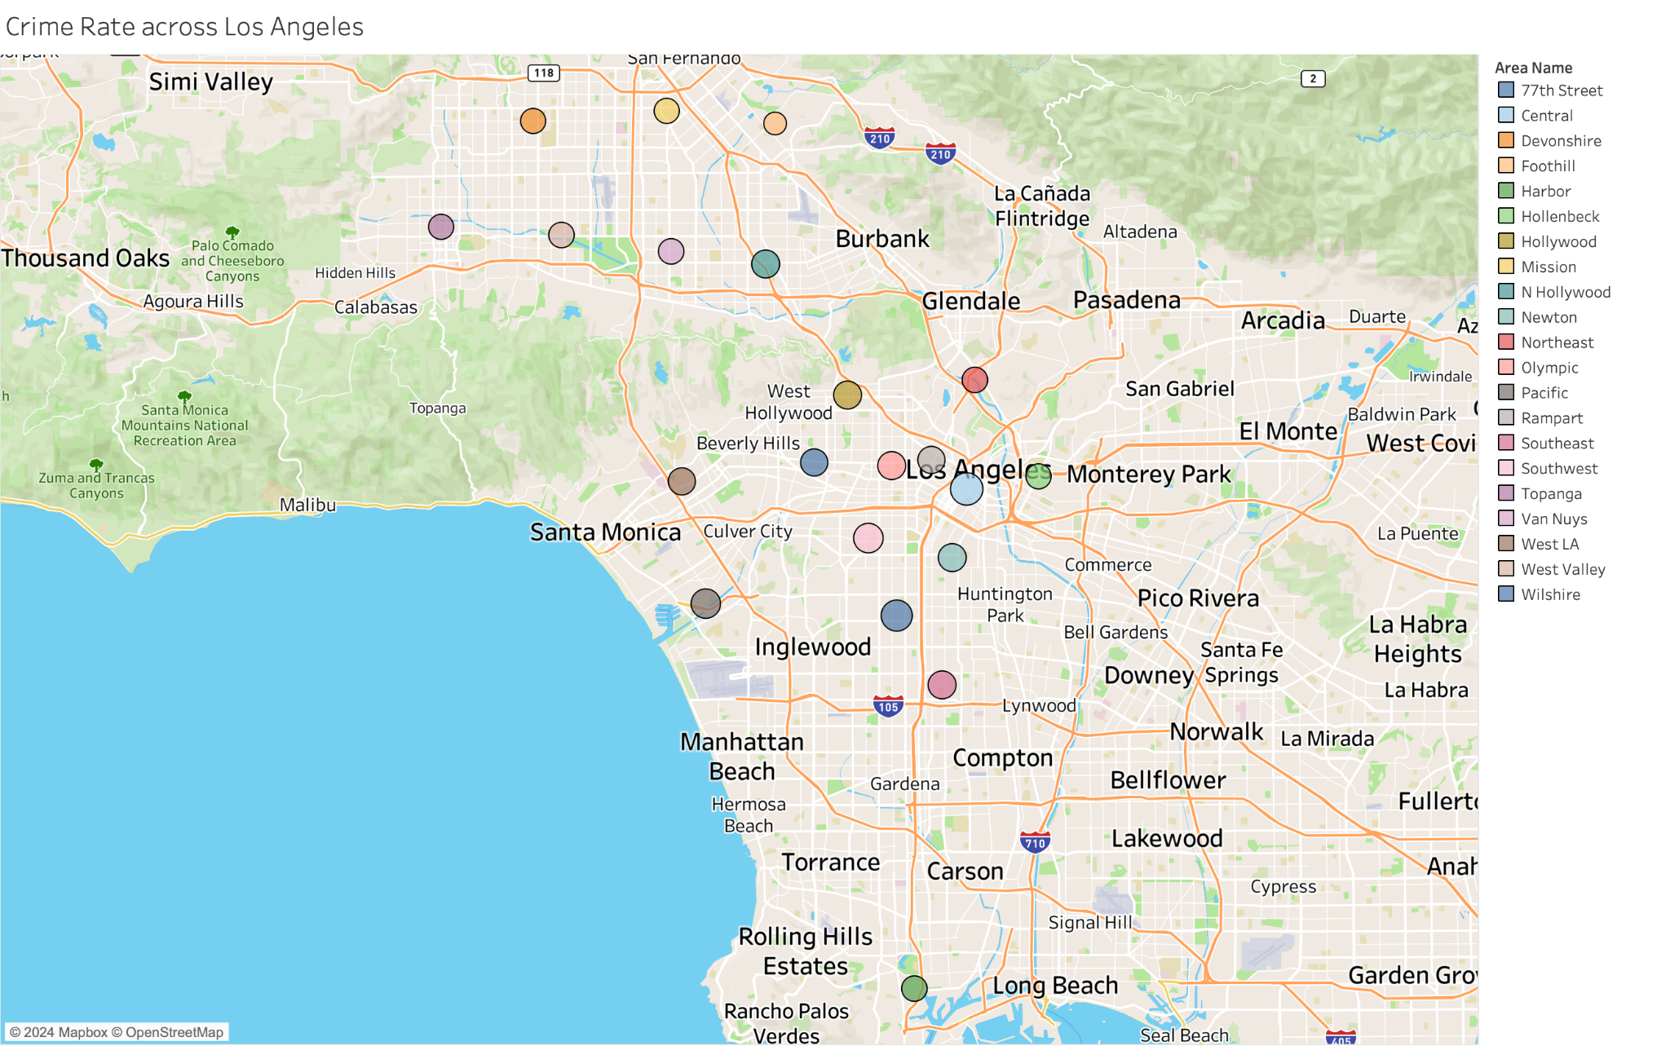
Geographical and Demographic Factors

Slide 17
Geographical and Demographic Factors
Are there noticeable patterns in weapon usage in crimes across different areas of the city?
Visualized the weapon usage by crime committers with the help of a pie chart
A total of 79 weapon categories are being used by crime committers on victims
"STRONG ARM" (hands, fists, etc.) is the most common weapon, used in about 61% of cases, indicating a prevalence of physical force. In contrast, "VEHICLE" used as a weapon occurs in only 1% of cases, highlighting its rarity compared to direct physical assaults.

Slide 18
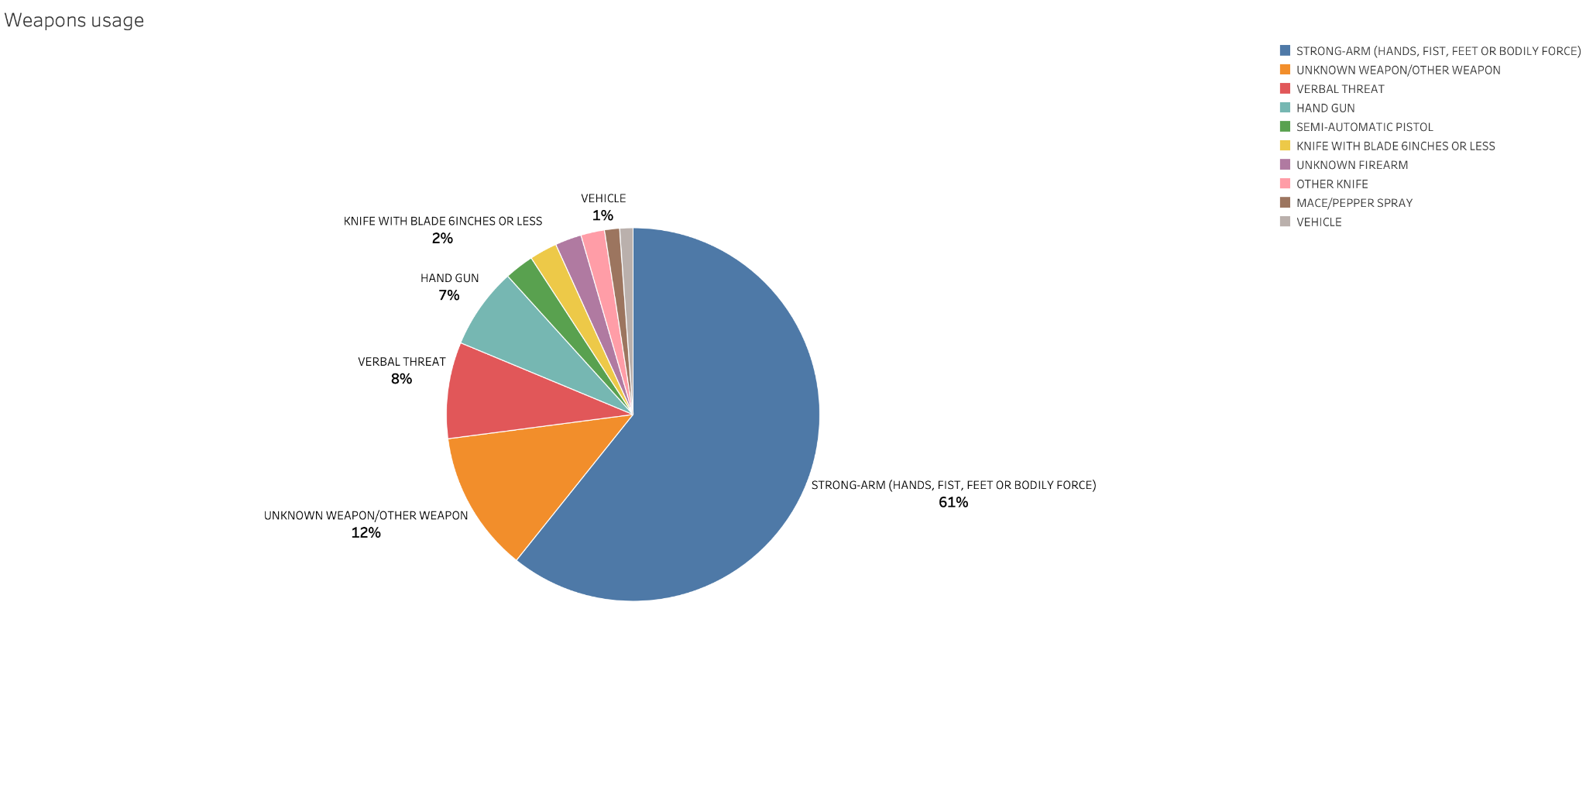
Geographical and Demographic Factors

Slide 19
Victimology
How does the profile of crime victims vary by gender and age?
We have used an area chart to visualise the Number of crime cases across victim age classified by gender
We have observed an anomaly due to improper data injection
Approximately 10,000 females aged 30 and 11,000 males aged 35 have been crime victims, indicating significant crime impact on early thirties demographics, with a higher incidence in males aged 35.

Slide 20
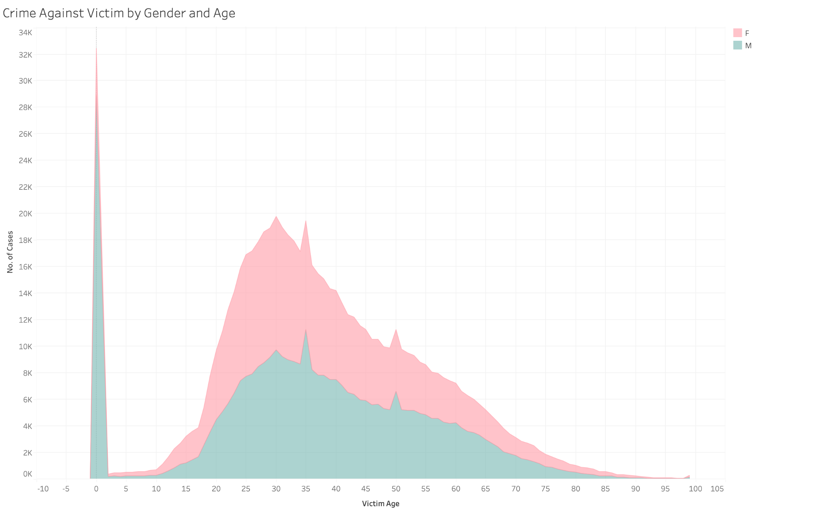
Victimology

Slide 21
Victim Analysis
What are the top 5 crimes reported for each gender?
A stacked percentage graph is plotted against the genders for each crime type
The top 5 are filtered and visualized
The chart showed that both the genders are equally assault by different categories of crime

Slide 22
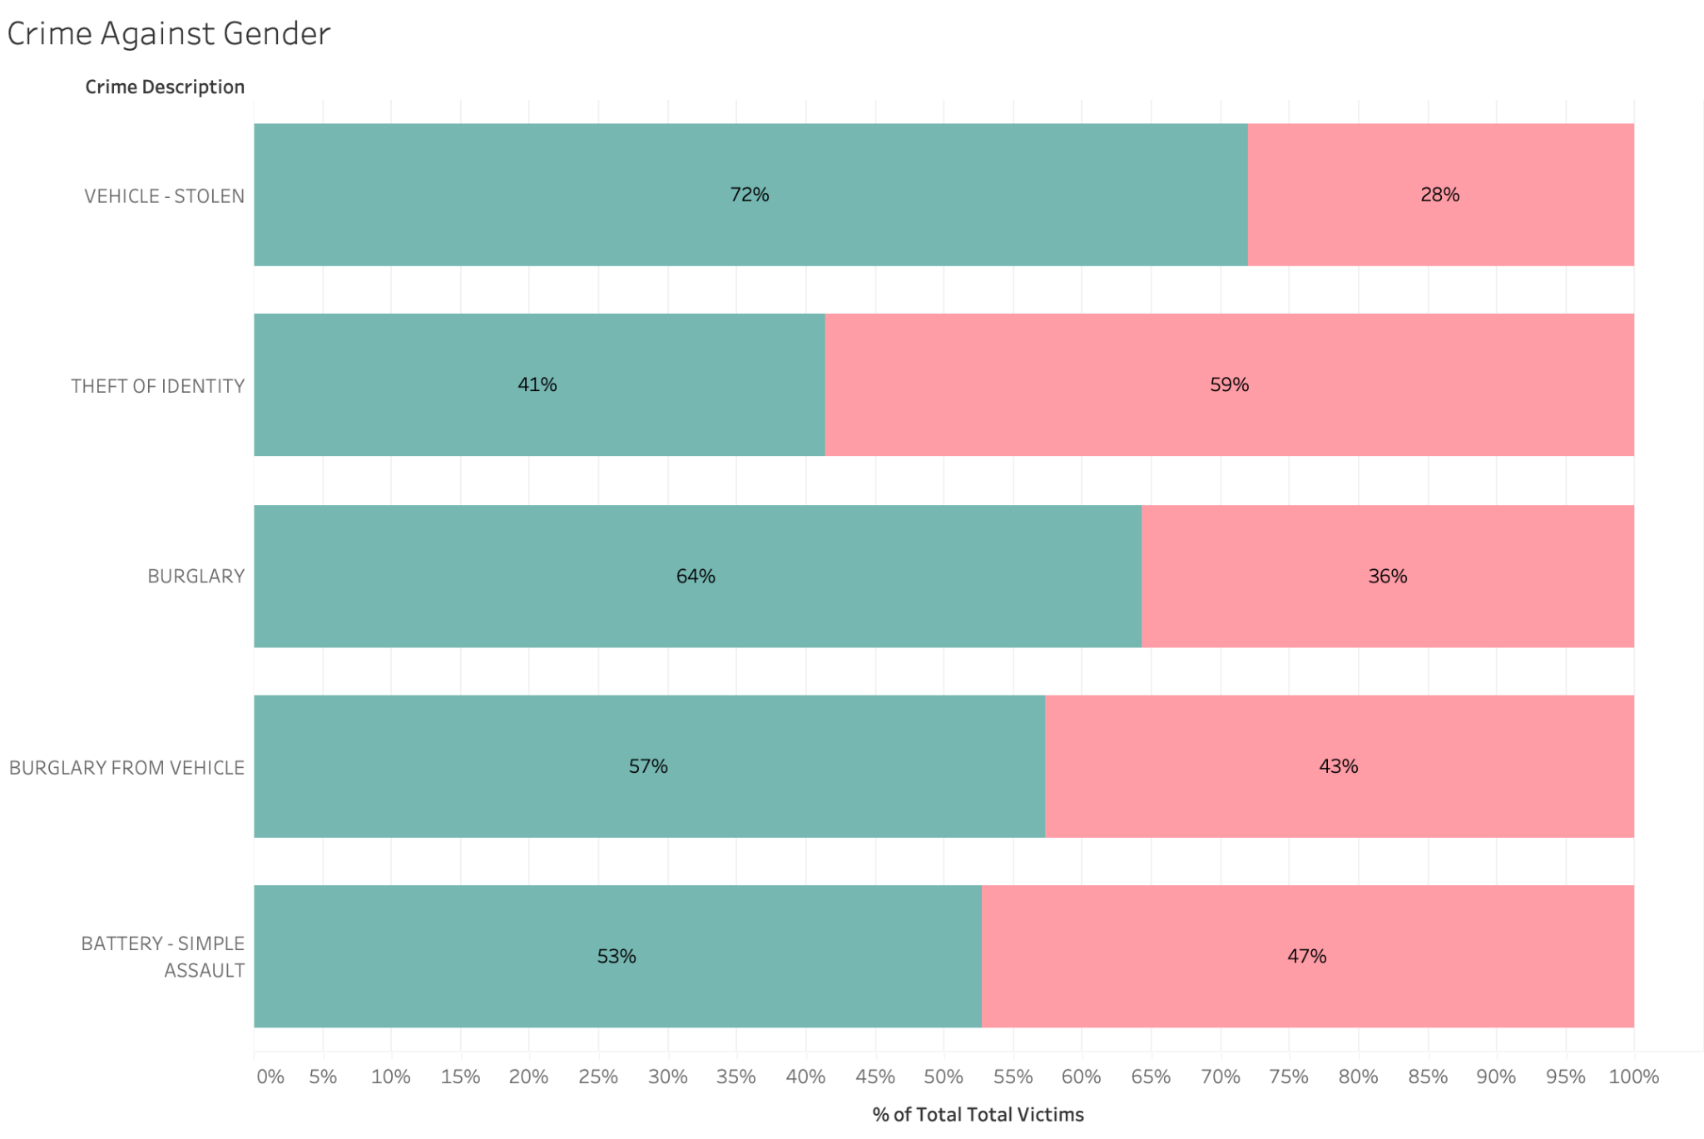
Victim Analysis

Slide 23
Victim Analysis
Where are the places that are likely crime to happen for different genders?
The Premises Description field is plotted against the total number of cases reported, categorised by Gender
A grouped bar chart is visualized to show the areas which are vulnerable for crime to happen
The top 5 places are visualized for better representation

Slide 24
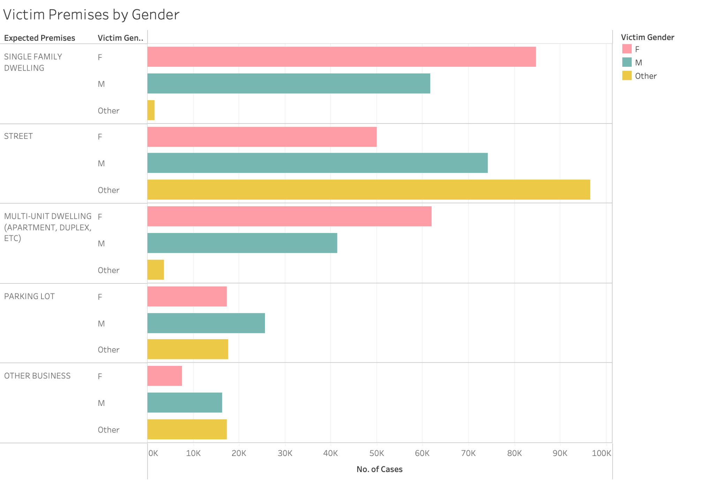
Victim Analysis

Slide 25
Impact Analysis
What insights can be drawn from the Crime Analysis and Crime Impact Dashboards in terms of overall public safety and crime prevention strategies?
To distinct dashboard are created from the visualization performed previously
Crime Analysis Dashboard provides interactive support to visualises the Geographical, Time and Categorisation analysis
Crime Impact Dashboard provides the users impacts of investigation status, gender based victimology and crime categorisation

Slide 26
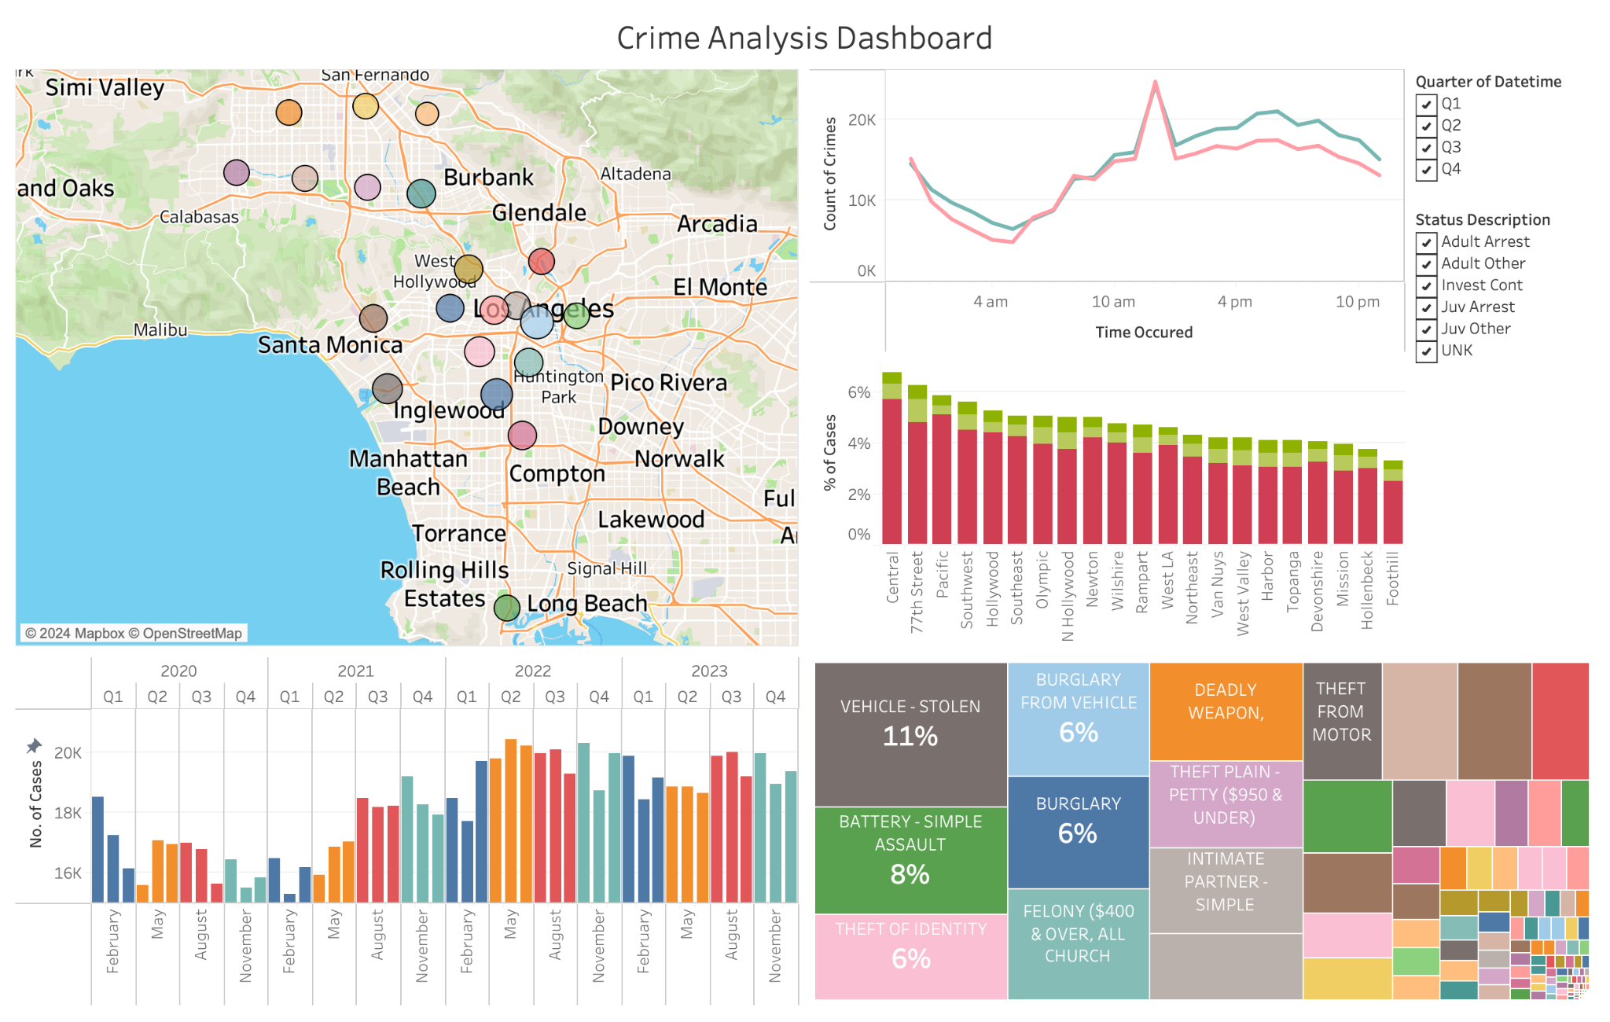
Crime Analysis Dashboard

Slide 27
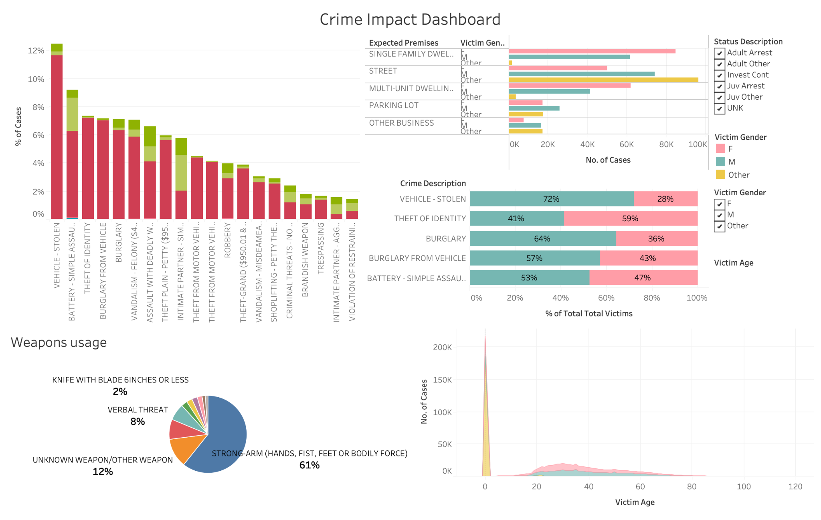
Crime Impact Dashboard

Slide 28
Lessons Learnt
Vehicle Stolen is the hottest crime reported ever in Los Angeles
Central Area is the most vulnerable area for crimes to happen
It is shown that crimes happen equally higher in both the streets and in home
Battery Assault were the most common crime against humans and Strong Arm were used in the most reported crime scenes
Regardless of Gender, both the genders were victims of crimes, where it is most for male in street and female in house

Slide 29
Limitations and Future Enhancement
Inaccurate data entry in the Gender and lack of description for it.
Lack of FIPS codes to process the maps efficiently
More visualisation on MoCodes
This Dashboard can be integrated with a real-time data source so that authorities can monitor process actions immediately

Slide 30
Thank You!

